Slide 1
Employee Segmentation using SPSS
Rajashri.N

Slide 2
Business Case
Data is collected from employees of different departments in a company via questionnaire.
Questions administered are provided in the next slide..

Slide 3
Questions
I am seeking for overseas job opportunities
I want a job where I can take up managerial or leadership roles
I want to be recognised for my talents
I don’t like to travel a lot
My job should allow me to learn new things
Prestige & status of job is very important
I need a job which gives me sufficient time to spend with my family
I'm willing to work in a start-up
My job should have flexible working hours and more holidays

Slide 4
Hierarchial Clustering
Using SPSS did the hierarchial clustering a=to find the number of clusters.
Dendrogram revealed that there are 3 clusters possible for given 24 records.
Also a scree plot of the coefficients revealed spike for observation 21.Therefore the number of clusters = 24 – 21 = 3

Slide 5
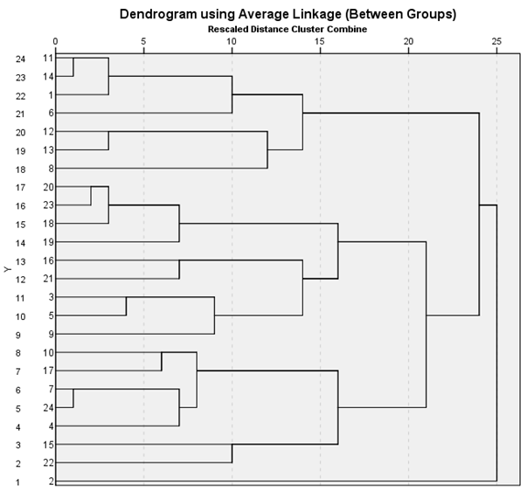
Dendrogram

Slide 6
Scree plot

Slide 7
K – Means Clustering
Using the number of clusters identified by SPSS,K means clustering is done.
K- Means will work based on the running means and iterations to have the cluster centers updated, having mean Euclidean distance between centers.

Slide 8
Initial Cluster Centers
Initial Cluster Centers
 | Cluster
 | 1 | 2 | 3
I am seeking for overseas job opportunities | 5 | 1 | 2
I want a job where I can take up managerial or leadership roles | 5 | 5 | 1
I want to be recognised for my talents | 4 | 5 | 5
I don’t like to travel a lot | 1 | 3 | 5
My job should allow me to learn new things | 4 | 5 | 3
Prestige & status of job is very important | 4 | 5 | 3
I need a job which gives me sufficient time to spend with my family | 4 | 2 | 5
I'm willing to work in a start-up | 5 | 1 | 4
My job should have flexible working hours and more holidays | 2 | 3 | 4

Slide 9
Final Cluster Centers
Final Cluster Centers
 | Cluster
 | 1 | 2 | 3
I am seeking for overseas job opportunities | 4 | 1 | 3
I want a job where I can take up managerial or leadership roles | 4 | 4 | 3
I want to be recognised for my talents | 4 | 4 | 4
I don’t like to travel a lot | 2 | 3 | 4
My job should allow me to learn new things | 4 | 5 | 4
Prestige & status of job is very important | 4 | 4 | 4
I need a job which gives me sufficient time to spend with my family | 4 | 3 | 4
I'm willing to work in a start-up | 4 | 1 | 4
My job should have flexible working hours and more holidays | 3 | 4 | 5

Slide 10
Distance Between Final cluster centers
Distances between Final Cluster Centers
Cluster | 1 | 2 | 3
1 |  | 4.340 | 3.548
2 | 4.340 |  | 4.212
3 | 3.548 | 4.212
Distance between each cluster center and each other.

Slide 11
Anova - Significance Check
ANOVA
 | Sig.
I am seeking for overseas job opportunities | .001
I want a job where I can take up managerial or leadership roles | .378
I want to be recognised for my talents | .959
I don’t like to travel a lot | .000
My job should allow me to learn new things | .050
Prestige & status of job is very important | .723
I need a job which gives me sufficient time to spend with my family | .688
I'm willing to work in a start-up | .086
My job should have flexible working hours and more holidays | .051
ANOVA Check shows that Question
I don t like to travel a lot has most significance than any other question.
Question “I want t o be reconised has least importance “.

Slide 12
Number of cases in each Clusters
Number of Cases in each Cluster
Cluster | 1 | 12.000
 | 2 | 2.000
 | 3 | 10.000
Valid |  | 24.000
Shows number of records possessed by each cluster

Slide 13
Interpretation
Interpretation of the clusters :
Cluster 1 : Shows people who are willing to travel and are seeking overseas opportunities. They are also willing to take up leadership roles.
Cluster 2 : Shows people who are willing to learn new things and are interested in taking up managerial roles.
Cluster 3 : Shows people who are willing to work in start ups. They are not inclined towards status and prestige of the job. They are eager to learn new things.

Slide 14
Thanks

